Slide 1
Lecture 9
Process Creation
National University of
Computer & Emerging Sciences

Slide 2
The fork() system call
At the end of the system call there is a new process waiting to run once the scheduler chooses it
A new data structure is allocated
The new process is called the child process.
The existing process is called the parent process.
The parent gets the child’s pid returned to it.
The child gets 0 returned to it.
Both parent and child execute at the same point after fork() returns

Slide 3
But we want the child process to do something else…
The fork syscall returns a zero to the child and the child process ID to the parent
int pid;
int status = 0;
pid = fork();
if (pid>0) {
/* parent */
……
pid = wait(&status);
} else {
/* child */
……
exit(status);
}
Parent uses wait to sleep until the child exits; wait returns child pid and status.
Wait variants allow wait on a specific child, or notification of stops and other signals
Fork creates an exact copy of the parent process
Child process passes status back to parent on exit, to report success/failure

Slide 4
Child Process Inherits
Stack
Memory
Environment
Open file descriptors.
Current working directory
Resource limits
Root directory

Slide 5
Child process DOESNOT Inherit
Process ID
Different parent process ID
Process times
Own copy of files
Resource utilization (initialized to zero)

Slide 6
The wait() System Call
A child program returns a value to the parent, so the parent must arrange to receive that value
The wait() system call serves this purpose
  pid_t wait(int *status)
  it puts the parent to sleep waiting for a child’s result
  when a child calls exit(), the OS unblocks the parent and returns the value passed by exit() as a result of the wait call (along with the pid of the child)
  if there are no children alive, wait() returns immediately
  also, if there are zombies, wait() returns one of the values immediately (and deallocates the zombie)
Notes:
The parent process will often want to wait until all child processes have been completed. this can be implemented with the wait() function call.
wait(): Blocks calling process until the child process terminates. If child process has already teminated, the wait() call returns immediately. if the calling process has multiple child processes, the function returns when one returns.
waitpid(): Options available to block calling process for a particular child process not the first one.

Slide 7
What is an orphan child?
If the parent terminates without calling wait(), the child is adopted by init.
The solution is:
Ensure that your parent process calls wait() or waitpid or etc, for every child process that terminates.
Notes:
A process can become orphaned during remote invocation when the client process crashes after making a request of the server
Orphans waste server resources and can potentially leave a server in trouble. However there are several solutions to the orphan process problem:
1. Extermination is the most commonly used technique; in this case the orphan process is killed.
2. Reincarnation is a technique in which machines periodically try to locate the parents of any remote computations; at which point orphaned processes are killed.
3. Expiration is a technique where each process is allotted a certain amount of time to finish before being killed. If need be a process may "ask" for more time to finish before the allotted time expires.
There is no such thing as "zombie process" under Windows, because, strictly speaking, there is no parent-child relationship under Windows. After a child
process has been spawned, it lives its separate life that is totally unrelated to that of a parent process - it will keep on running even after its parent process gets terminated.
As you have properly pointed out, when a process terminates, all handles that it has opened get closed. Therefore, when the parent process terminates,
all its handles are closed, so that reference count on the child process gets decremented. When the reference count gets down to zero, the process
gets removed from the table.

Slide 8
What is a zombie?
In the interval between the child terminating and the parent calling wait(), the child is said to be a ‘zombie’.
Even though its not running its taking up an entry in the process table.
The process table has a limited number of entries.
Notes:
A zombie process is not the same as an orphan process. An orphan process is a process that is still executing, but whose parent has died. They do not become zombie processes; instead, they are adopted by init (process ID 1), which waits on its children.
On Unix and Unix-like computer operating systems, a zombie process or defunct process is a process that has completed execution but still has an entry in the process table. This entry is still needed to allow the process that started the (now zombie) process to read its exit status. The term zombie process derives from the common definition of zombie—an undead person. In the term's colorful metaphor, the child process has died but has not yet been reaped. Also, unlike normal processes, the kill command has no effect on a zombie process.
When a process ends, all of the memory and resources associated with it are deallocated so they can be used by other processes. However, the process's entry in the process table remains. The parent can read the child's exit status by executing the wait system call, at which stage the zombie is removed. The wait call may be executed in sequential code, but it is commonly executed in a handler for the SIGCHLD signal, which the parent receives whenever a child has died.
After the zombie is removed, its process ID and entry in the process table can then be reused. However, if a parent fails to call wait, the zombie will be left in the process table. In some situations this may be desirable, for example if the parent creates another child process it ensures that it will not be allocated the same process ID. On modern UNIX-like systems (that comply with SUSv3 specification in this respect), the following special case applies: if the parent explicitly ignores SIGCHLD by setting its handler to SIG_IGN (rather than simply ignoring the signal by default) or has the SA_NOCLDWAIT flag set, all child exit status information will be discarded and no zombie processes will be left.
Since there is no memory allocated to zombie processes except for the process table entry itself, the primary concern with many zombies is not running out of memory, but rather running out of process ID numbers.
To remove zombies from a system, the SIGCHLD signal can be sent to the parent manually, using the kill command. If the parent process still refuses to reap the zombie, the next step would be to remove the parent process. When a process loses its parent, init becomes its new parent. Init periodically executes the wait system call to reap any zombies with init as parent.

Slide 9
exit()
void exit(int status);
After the program finishes execution, it calls exit()
This system call:
  takes the “result” of the program as an argument
  closes all open files, connections, etc.
  deallocates memory
  deallocates most of the OS structures supporting the process
  checks if parent is alive:
    If so, it holds the result value until parent requests it, process does not really die, but it enters the zombie/defunct state
    If not, it deallocates all data structures, the process is dead

Slide 10
exec()
We usually want the child process to run some other executable
For Example, ls - list directory contents
Overlays, performed by the family of exec system calls, can change the executing program, but can not create new processes.
Notes:
exec is the name of a family of functions that includes execl, execv, execle, execve, execlp, and execvp. They all have the function of transforming the calling process into a new process. The reason for the variety is to provide different ways of pulling together and presenting the arguments of the function.
There shall be no return from a successful exec, because the calling process image is overlaid by the new process image.
A call to any exec function from a process with more than one thread shall result in all threads being terminated and the new executable image being loaded and executed. No destructor functions or cleanup handlers shall be called.
If one of the exec functions returns to the calling process image, an error has occurred; the return value shall be -1, and errno shall be set to indicate the error.
The new process shall inherit at least the following attributes from the calling process image:
Process ID
Parent process ID
Process group ID
Session membership
Real user ID
Real group ID
Supplementary group IDs
Time left until an alarm clock signal (see alarm())
Current working directory
Root directory
File mode creation mask (see umask())
File size limit (see ulimit())
Process signal mask (see sigprocmask())
Pending signal (see sigpending())
Resource limits
Controlling terminal
Interval timers
The initial thread of the new process shall inherit at least the following attributes from the calling thread:
Signal mask (see sigprocmask() and pthread_sigmask())
Pending signals (see sigpending())

Slide 11
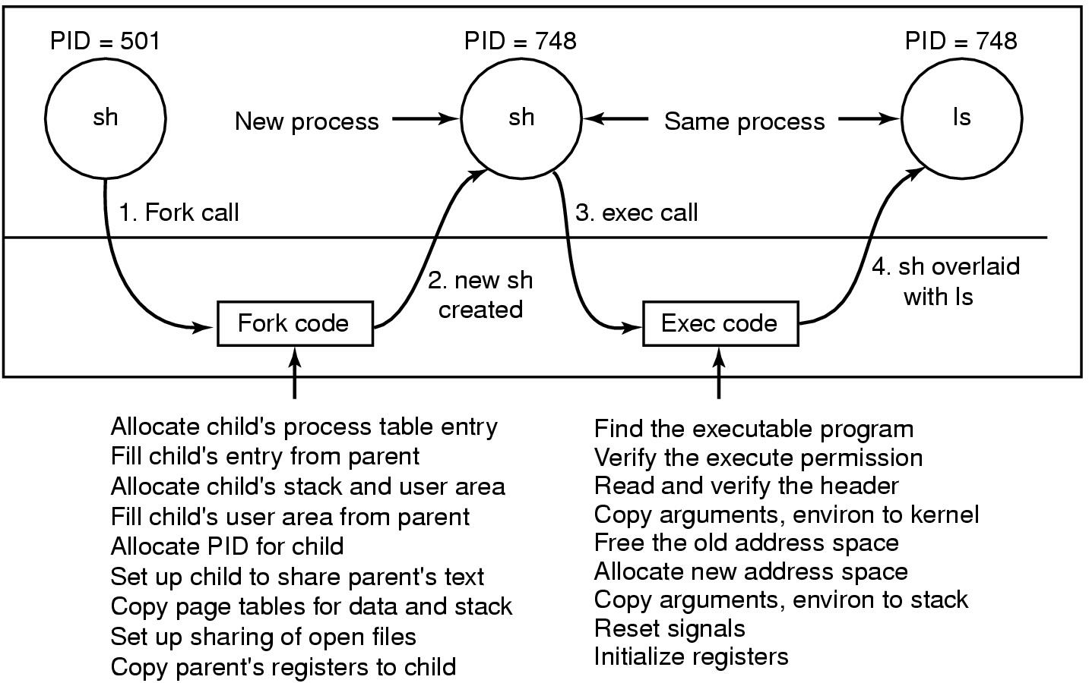
The ls Command
Steps in executing the command ls type to the shell

Slide 12
When a process executes exec, no new process is created.
The calling process is overwritten by the program whose filename is passed as the first argument.

Slide 13
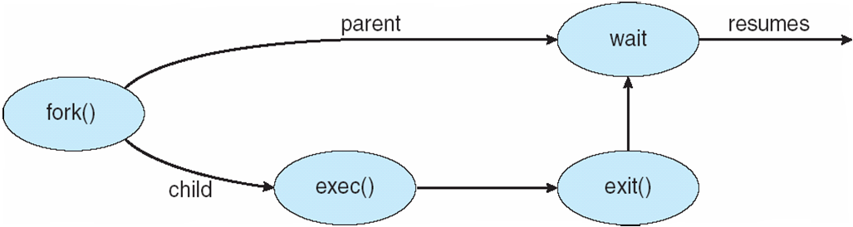

Slide 14
execv
int execv(const char *path, char *const argv[]);
the current process image with a new process image.
path is the filename to be executed by the child process
When a C-language program is executed as a result of this call, it is entered as a C-language function call as follows:
  int main (int argc, char *argv[]);
The argv array is terminated by a null pointer.
The null pointer terminating the argv array is not counted in argc.
Notes:
if (fork() == 0) /* in child */
execl("/bin/sh", "sh", "-c", cmd, NULL);
And in fact, except for handling errors, this is sufficient. The fork is zero, so it calls execl which does the cmd and then dies. In the parent, fork returns non-zero so it skips the execl. (If there is any error, fork returns -1).

Slide 15
main()
{
pid_t pid;
char *const parmList[] = {"/bin/ls", "-l", "/u/userid/dirname", NULL};
if ((pid = fork()) == -1)
perror("fork error");
else if (pid == 0) {
execv("/bin/ls", parmList);
printf("Return not expected. Must be an execv error.n");
}
}

Slide 16
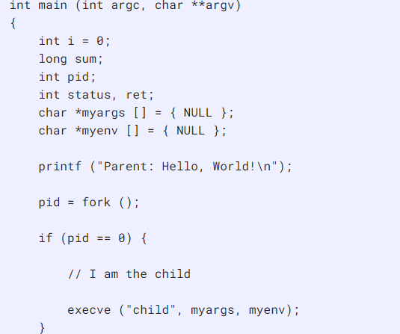

Parent.C

Slide 17
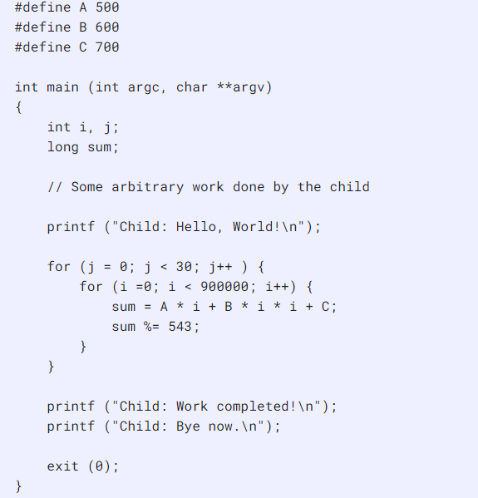
Child.c

Slide 18
How can a parent and child process communicate?
Through any of the normal IPC mechanism schemes.
But have special ways to communicate
  For example
    The variables are replicas
    The parent receives the exit status of the child

Slide 19
How can a parent and child process communicate?
Through any of the normal IPC mechanism schemes.
But have special ways to communicate
  For example
    The variables are replicas
    The parent receives the exit status of the child

